Slide 1
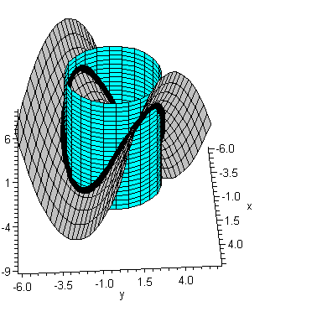
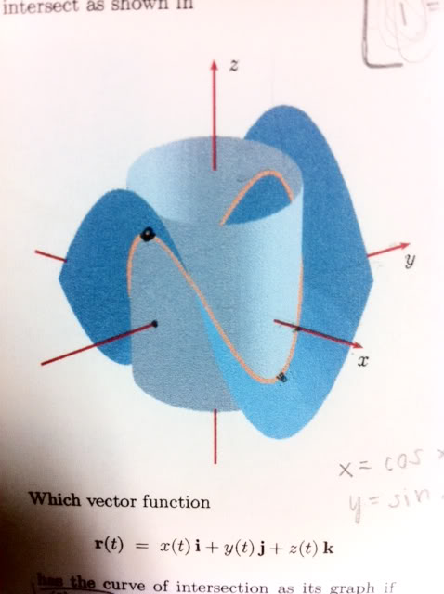
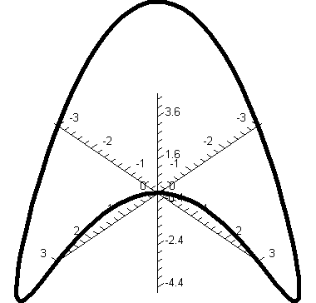
Intersection of hyperbolic paraboloid (saddle) and cylinder
surface
Tutorial 8 Q6
Surface defined
on the base
of cylinder

Slide 2
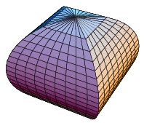
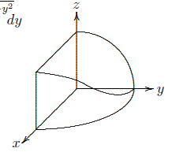
Intersection of two cylinders
z
z
y
x
y
Volume of the solid
x
8 times of the volume of this solid
Tutorial 8 Q2
http://www.math.tamu.edu/~Tom.Kiffe/calc3/newcylinder/2cylinder.html

